Slide 1
Virtual Reality
by Rainer Zoettl
rainer@awfullynicestudios.com

Slide 2

Who is this guy?
Over 12 years experience in VFX and Games:
Avatar
District9
Hobbit
Avengers
World of Warcraft
Diablo
Starcraft
...

Slide 3

What’s in it for you?
1.) Theory:
History of VR
AR vs. VR
VR HMD’s
VR Tech
VR Input
3D Primer
3D Objects
Polygons
Animations
etc.
2.)Hands on:
Unity Primer
Create a project
Compile it for Google Cardboard

Slide 4
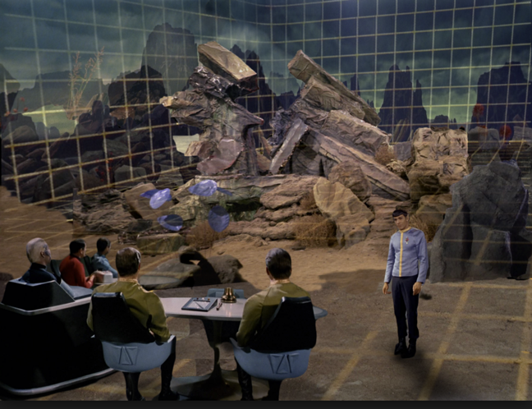
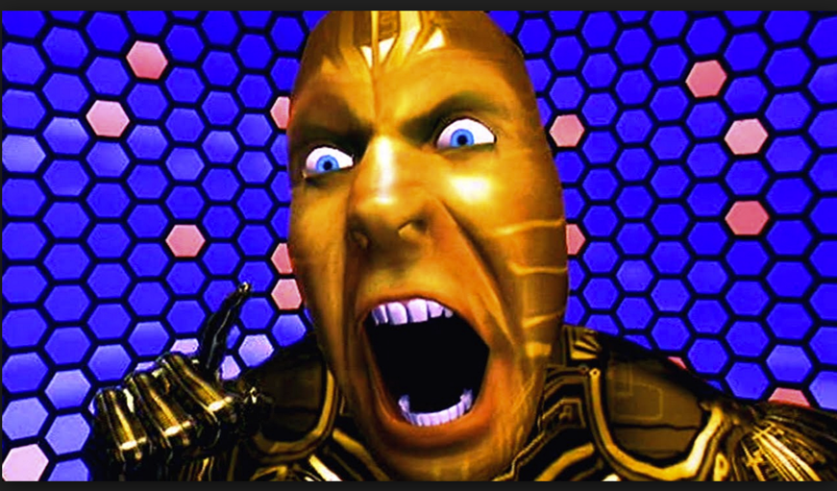
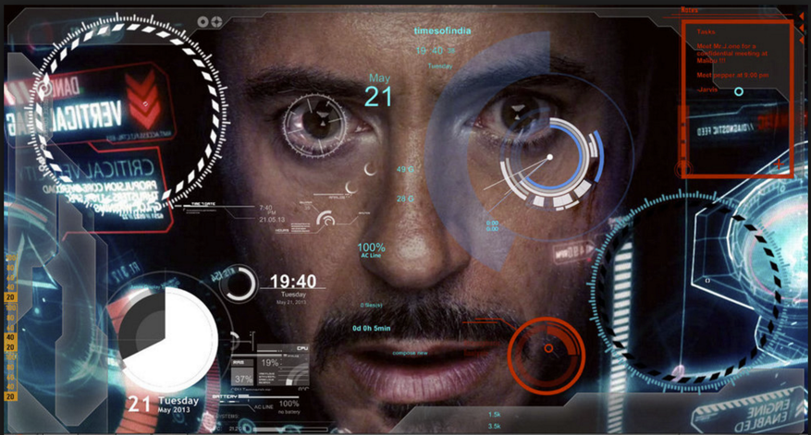
HISTORY
Movie makers dream about a virtual reality since a long time. Holodecks, Virtual Worlds and Augmented Realities are closer then ever before to become a reality. Tech companies receive billion of dollars in funds to make this work. If you want to do something with VR, THIS is the time to get started.

Slide 5
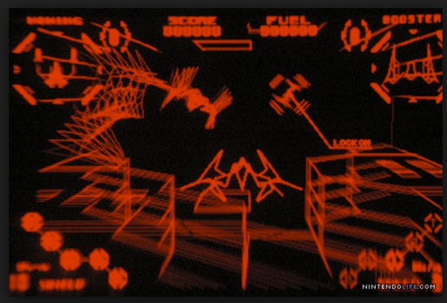
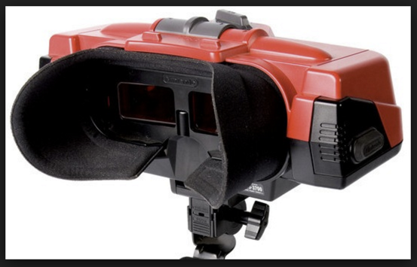
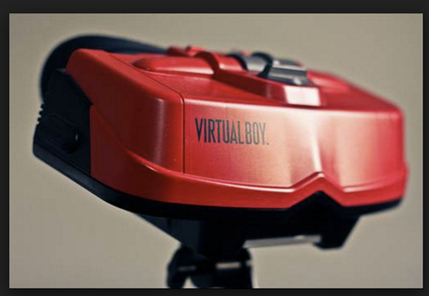
HISTORY
Humans dream to be in an alternate Reality since computers were able to draw graphics.
Early attempts failed because of the bad hardware. Nintendo was one of the first ones in 1995 which released a headset called “Virtual Boy”. It had only 1 color and after a few minutes using it you got a terrible headache.

Slide 6
AR vs. VR
AR
VR
Augmented Reality
Partial integration of computer graphics in the real world
Total immersion in a different virtual reality created with computer graphics
AR Glasses need to 3D track the environment in order to integrate computer graphics.
Popular examples of AR:
Microsoft Hololens
Magic Leap (funded by Google)
VR immersion is more tricky to achieve because of all the elements you need to have in virtual reality.
Popular examples of VR:
Oculus Rift
The Void (for immersion example)

Slide 7
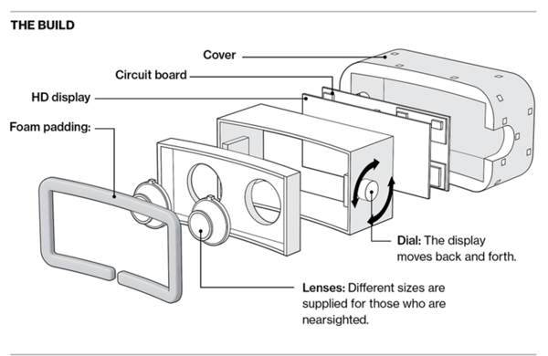
VR Tech
What do we need for VR?
Hardware
HMD’s + fast Desktop machine
Smartphone + Cardboard
optional inputs
Interactive Software
3D Objects

Slide 8
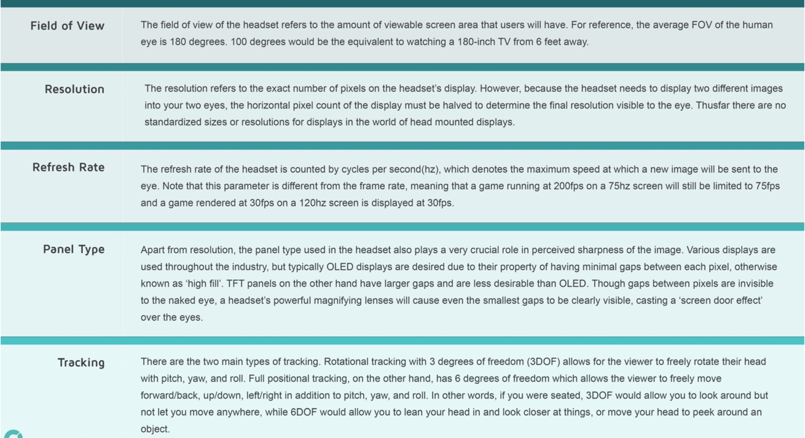
VR Tech

Slide 9
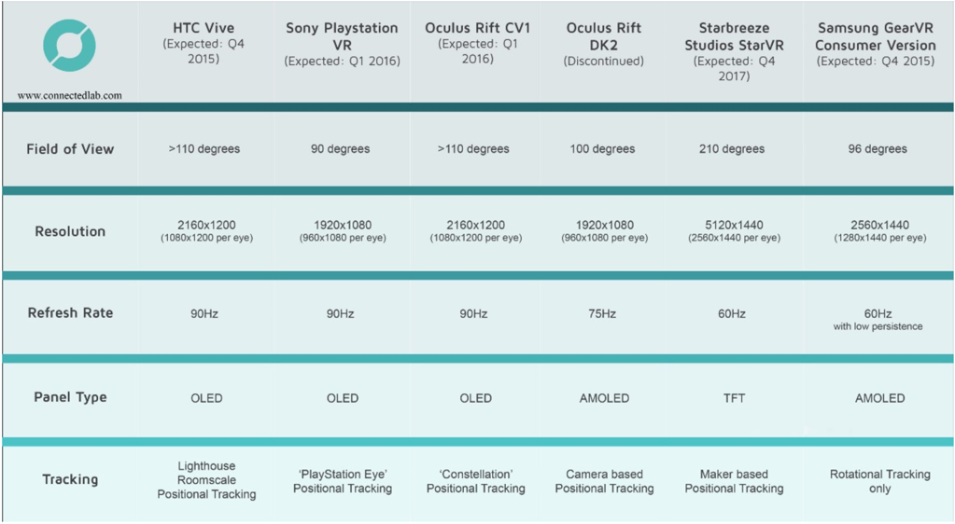
VR HMD (head mounted displays)
VR HMD’s

Slide 10
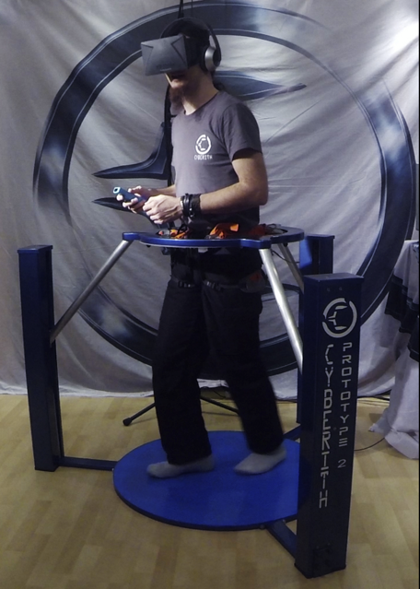
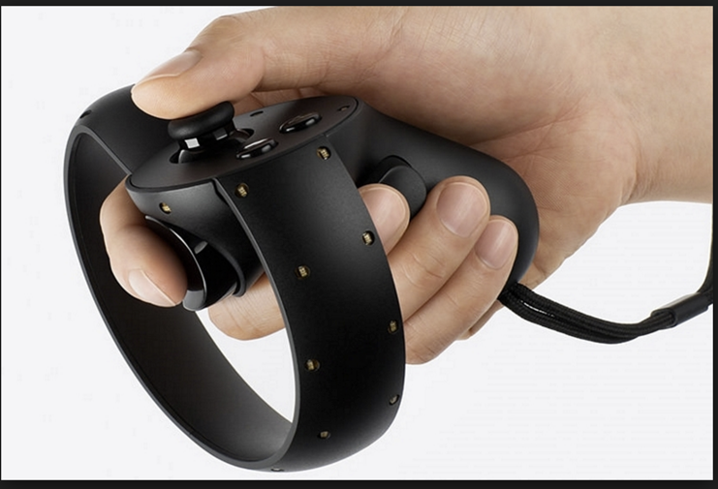
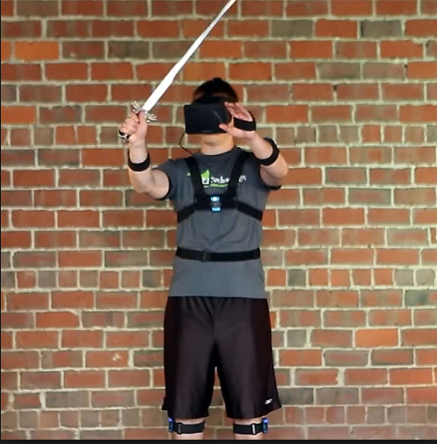
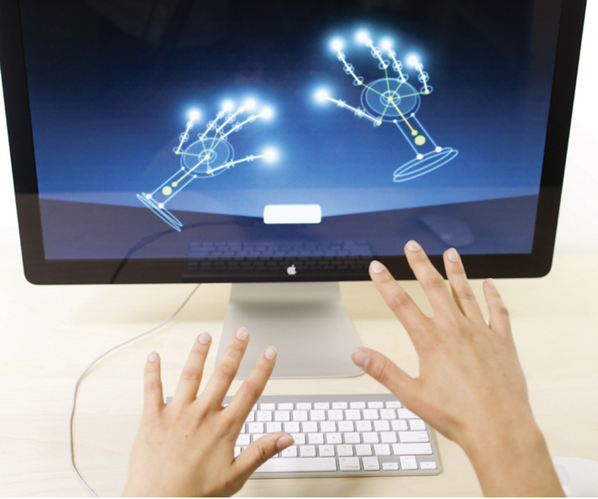
VR Inputs

Slide 11
VR Future and Challenges
Motion sickness
Due to latency issues people reporting severe motion sickness after usage
Resolution at least 4K per eye
Because the screen is so close to the eye you need a lot of resolution to not see any pixels anymore
Positional tracking
There are solutions out there like the lighthouse tracking but once you cover the sensor the system breaks.
Simulating other senses like touch and etc.
This will be the biggest challenge. How do you touch something simple like a glass and possible feel it’s weight?

Slide 12
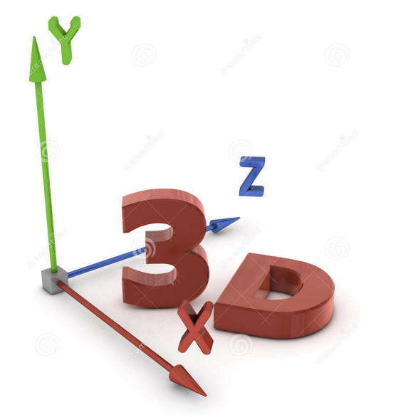
VR needs 3D content
3D Objects terminology:
Model
Texture coordinates
Textures
Lights
Cameras
Materials
Rigging
Animation

Slide 13
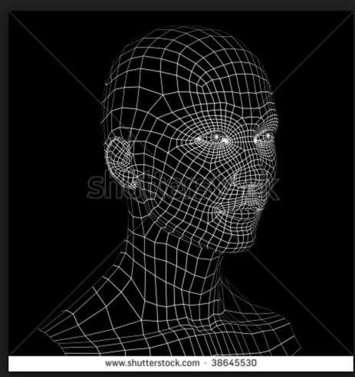
3D - Model
A 3D polygonal model exists of:
Vertices
Edges
Polygons
Normals
Texture coordinates

Slide 14
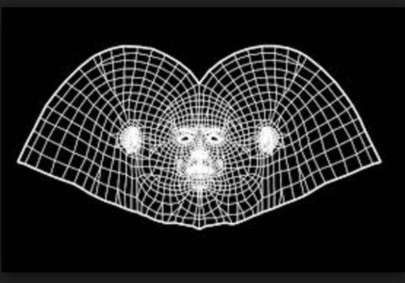
3D - Texture coordinates = UV’s
A 2D representation of the 3D model
We need this to be able to put textures on the 3D model

Slide 15
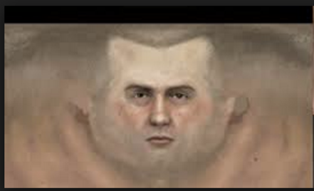
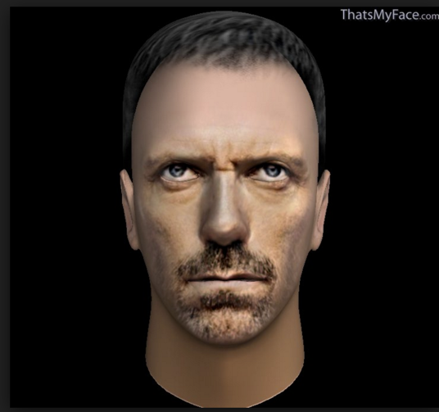
3D - Textures
Photoshop is used to paint over the texture coordinates

Slide 16
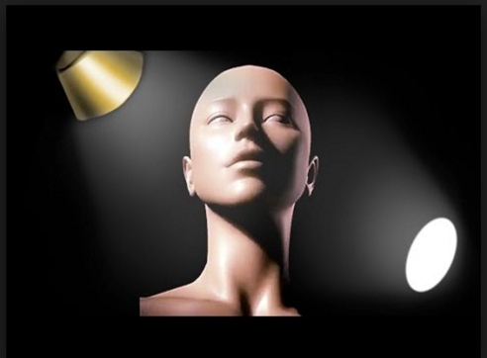
3D - Lights
Lights are placed in 3D space to simulate lighting. Popular lighting systems are:
Spotlight
Directional light
Raytrayced light
Global Illumination
HDR lighting

Slide 17
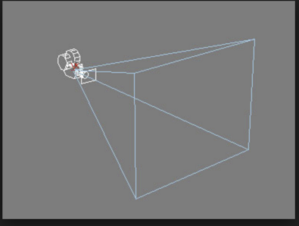
3D - Cameras
A camera is just like in real life a object to view the 3D scene.
Common settings are:
FOV
Position
Rotation
Clipping Planes

Slide 18
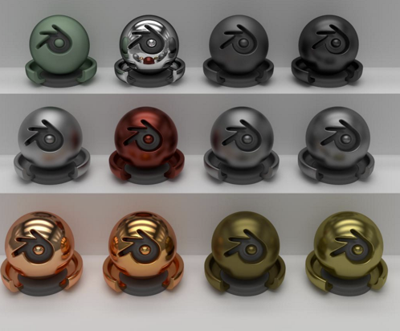
3D - Materials
The settings of a material define the surface of a 3D Model
Properties:
Shaders
Textures
Shininess
Reflectivity
etc.

Slide 19
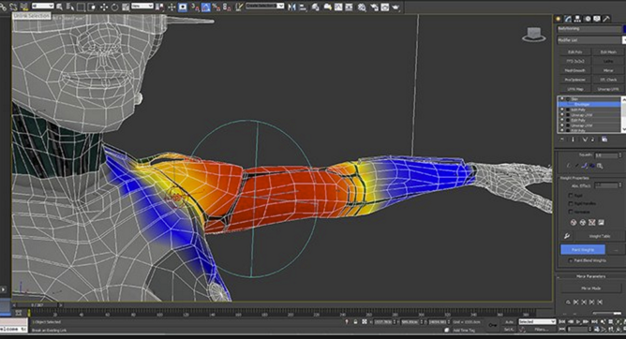
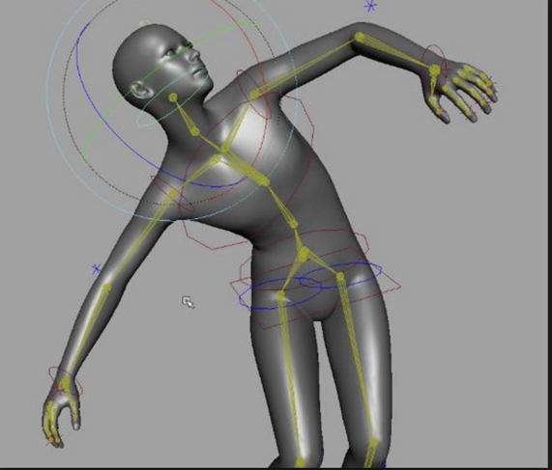
3D - Rigging
A 3D model needs to have bones which get connected to the 3D model. This process gets called “skinning”.
Properties:
Shaders
Textures
Shininess
Reflectivity
etc.

Slide 20
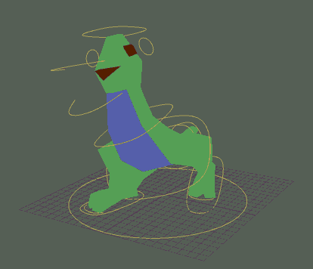
3D - Animation
A RIG gets used to control and animate a 3D model
Properties:
Shaders
Textures
Shininess
Reflectivity
etc.

Slide 21
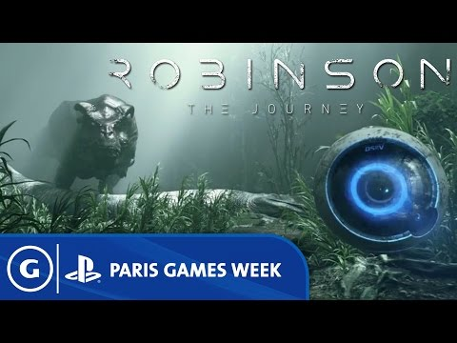
Final Scene
All 3D models are loaded
Animation get’s applied
Lightning get’s added
Effects
Sound
Interacting Scripts

